Slide 1
Lab 4: Implement the Digital to Analog Converter Using Op-Amp
EE316-08 Spring 2021

Slide 2
Purpose: The goal of this laboratory is to explore how an Op-Amp and binary resistive ladder network can be used to construct a simple Digital to Analog (D/A) Converter. The concepts of step size, maximum output range, resolution, and accuracy will also be introduced.

Slide 3
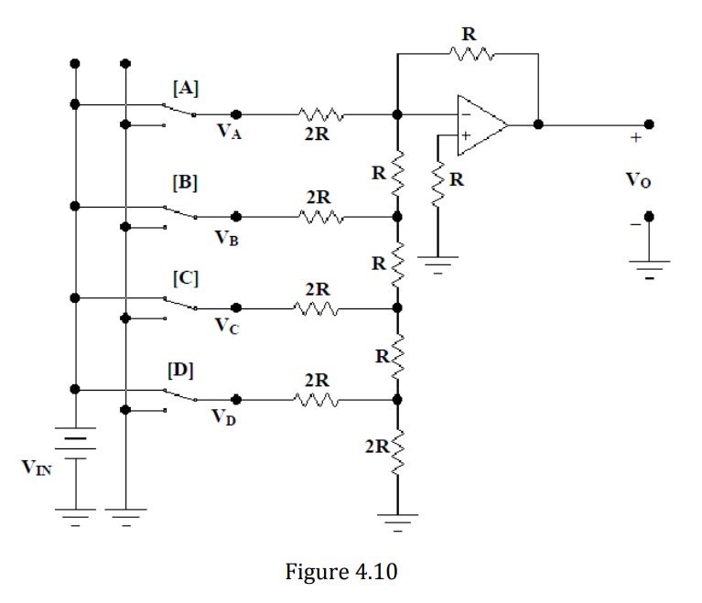
An R-2R D/A Converter Circuit Background
A digital-to-analog converter (D/A) is a circuit that converts digital data (binary number) into an analog output (voltage).
In this lab…
The digital data input, which is in the form of binary number, can go from 0 to 15.
The output is a voltage that is proportional to the binary input.
As you can observe, there are two different resistor values (R and 2R) in the ladder network.
Digital Input
Analog Output
1
0
1
0
1
0
1
0
Note: Binary numbers are base 2 numbers and have only two values – and .
1
0

Slide 4
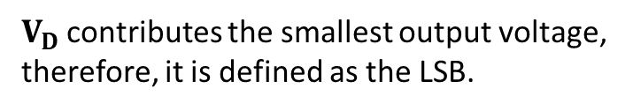
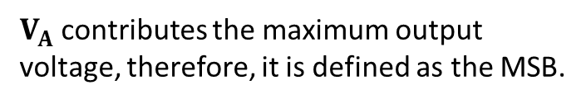
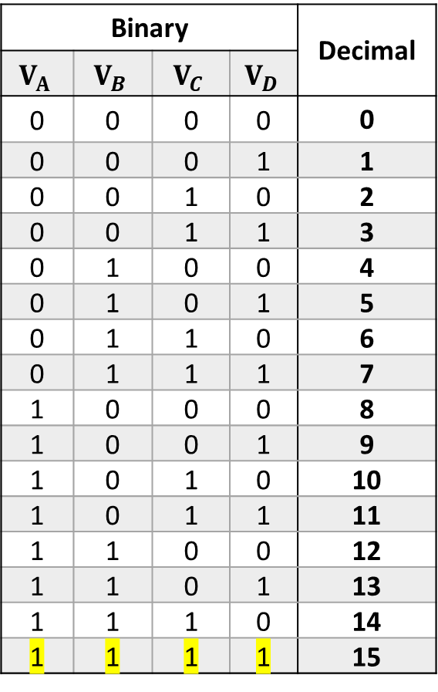
The Digital Input
$V_{A}$ contributes the maximum output voltage, therefore, it is defined as the MSB.
Binary |  |  |  | Decimal
$$V_{A}$$ | $$V_{B}$$ | $$V_{C}$$ | $$V_{D}$$
0 | 0 | 0 | 0 | 0
0 | 0 | 0 | 1 | 1
0 | 0 | 1 | 0 | 2
0 | 0 | 1 | 1 | 3
0 | 1 | 0 | 0 | 4
0 | 1 | 0 | 1 | 5
0 | 1 | 1 | 0 | 6
0 | 1 | 1 | 1 | 7
1 | 0 | 0 | 0 | 8
1 | 0 | 0 | 1 | 9
1 | 0 | 1 | 0 | 10
1 | 0 | 1 | 1 | 11
1 | 1 | 0 | 0 | 12
1 | 1 | 0 | 1 | 13
1 | 1 | 1 | 0 | 14
1 | 1 | 1 | 1 | 15
MSB
1
0
1
0
1
0
1
LSB
0
$V_{D}$ contributes the smallest output voltage, therefore, it is defined as the LSB.
The Most Significant Bit
(MSB)
The Least Significant Bit
(LSB)

Slide 5
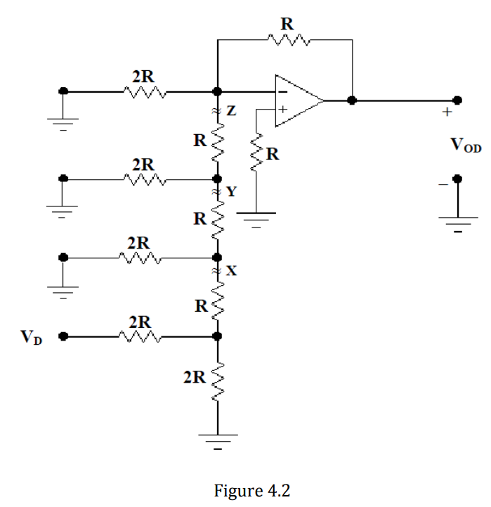
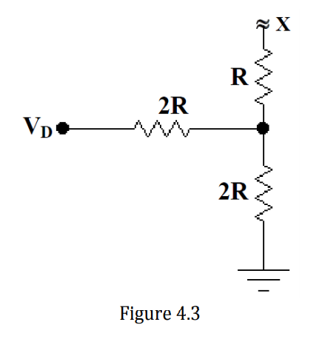
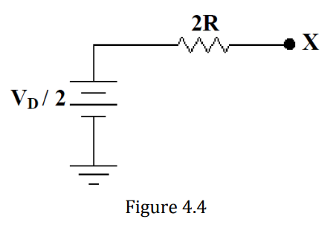
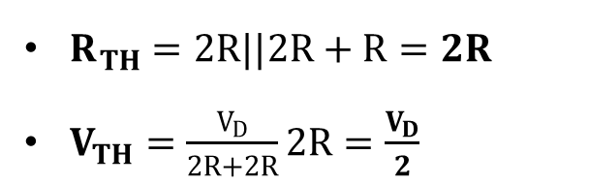
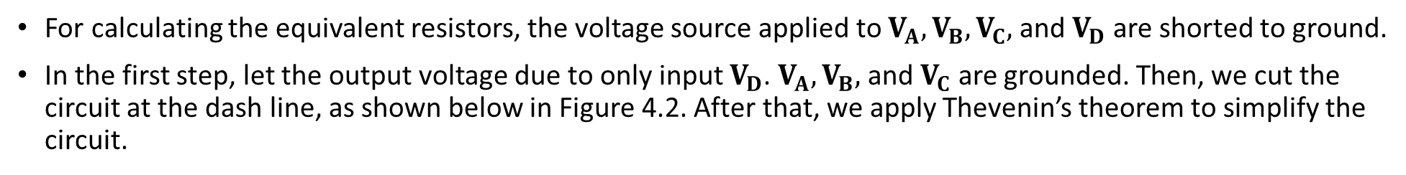
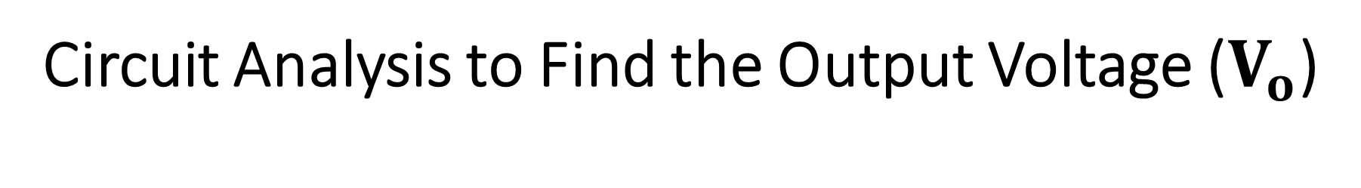
Circuit Analysis to Find the Output Voltage ($V_{o}$)
For calculating the equivalent resistors, the voltage source applied to $V_{A},V_{B},V_{C},$ and $V_{D}$ are shorted to ground.
In the first step, let the output voltage due to only input $V_{D}$. $V_{A},V_{B},$ and $V_{C}$ are grounded. Then, we cut the circuit at the dash line, as shown below in Figure 4.2. After that, we apply Thevenin’s theorem to simplify the circuit.
Thevenin’s Theorem
$R_{TH}=2R||2R+R=2R$
$V_{TH}=\frac{V_{D}}{2R+2R}2R=\frac{V_{D}}{2}$

Slide 6
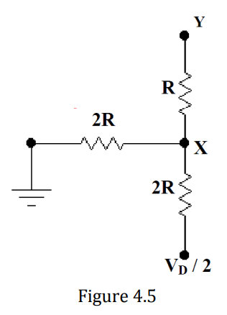
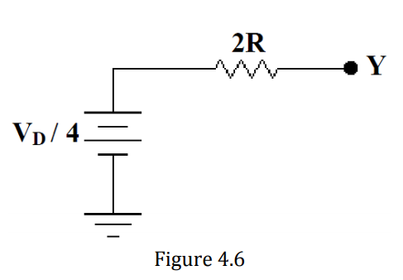
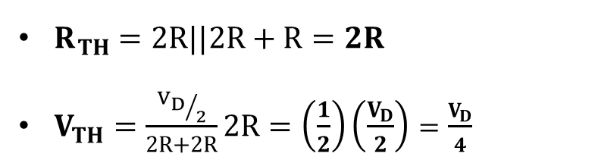
Circuit Analysis to Find the Output Voltage ($V_{o}$) (cont.)
Second, we cut the circuit at the jagged line Y or the dash line shown below in Figure 4.2.
Apply Thevenin’s Theorem
$R_{TH}=2R||2R+R=2R$
$V_{TH}=\frac{{V_{D}}/2}{2R+2R}2R=\left(\frac{1}{2}\right)\left(\frac{V_{D}}{2}\right)=\frac{V_{D}}{4}$

Slide 7
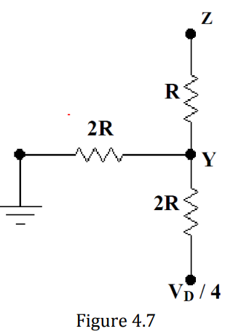
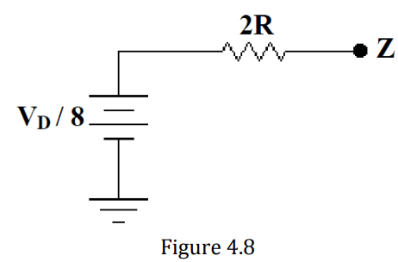
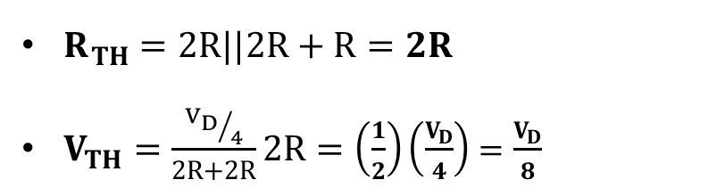
Circuit Analysis to Find the Output Voltage ($V_{o}$) (cont.)
Third, we cut the circuit at the jagged line Z or the dash line shown below in Figure 4.2.
Apply Thevenin’s Theorem
$R_{TH}=2R||2R+R=2R$
$V_{TH}=\frac{{V_{D}}/4}{2R+2R}2R=\left(\frac{1}{2}\right)\left(\frac{V_{D}}{4}\right)=\frac{V_{D}}{8}$

Slide 8
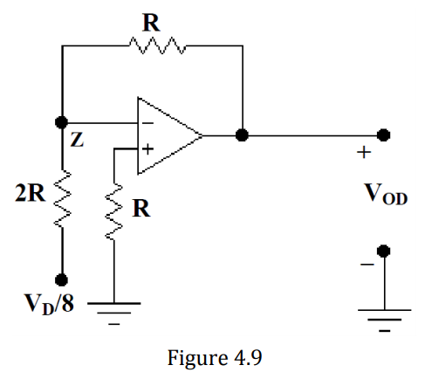
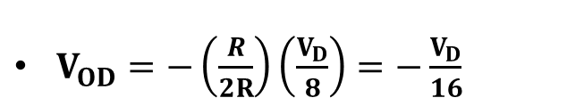
Circuit Analysis to Find the Output Voltage ($V_{o}$) (cont.)
It is not necessary to include this resistor because the terminal at point Z is a virtual ground.
Z
Help with noise and for safety
Calculate $V_{OD}$ or the output voltage contributed by $V_{D}$
$V_{OD}=−\left(\frac{R}{2R}\right)\left(\frac{V_{D}}{8}\right)=−\frac{V_{D}}{16}$

Slide 9
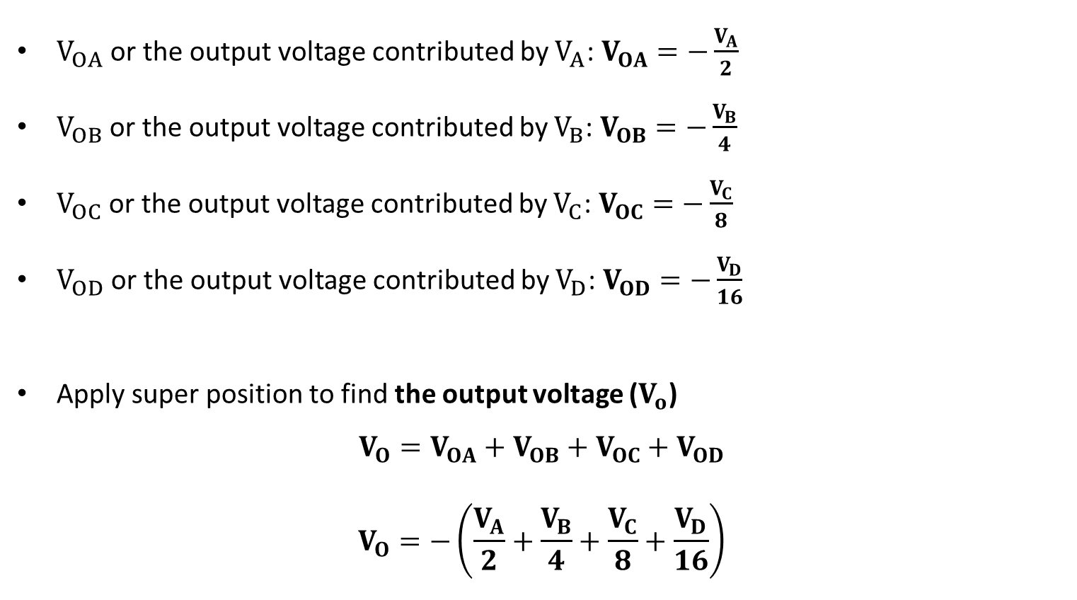
Circuit Analysis to Find the Output Voltage ($V_{o}$) (cont.)
$V_{OA}$ or the output voltage contributed by $V_{A}$: $V_{OA}=−\frac{V_{A}}{2}$
$V_{OB}$ or the output voltage contributed by $V_{B}$: $V_{OB}=−\frac{V_{B}}{4}$
$V_{OC}$ or the output voltage contributed by $V_{C}$: $V_{OC}=−\frac{V_{C}}{8}$
$V_{OD}$ or the output voltage contributed by $V_{D}$: $V_{OD}=−\frac{V_{D}}{16}$
Apply super position to find the output voltage ($V_{o}$)
$$V_{O}=V_{OA}+V_{OB}+V_{OC}+V_{OD}$$
$$V_{O}=−\left(\frac{V_{A}}{2}+\frac{V_{B}}{4}+\frac{V_{C}}{8}+\frac{V_{D}}{16}\right)$$

Slide 10
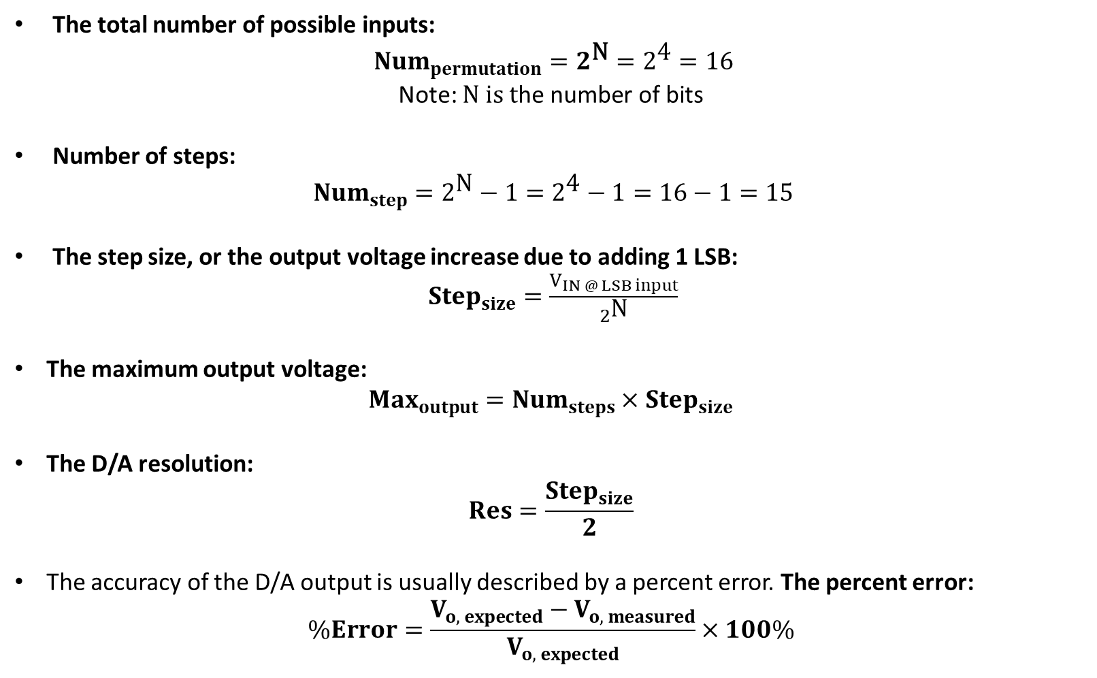
The total number of possible inputs:
${Num}_{permutation}=2^{\text{N}}=2^{\text{4}}=16$
Note: $\text{N} \text{is} \text{t}\text{he} \text{number} \text{of} \text{bits}$
Number of steps:
${Num}_{step}=2^{\text{N}}−1=2^{\text{4}}−1=16−1=15$
The step size, or the output voltage increase due to adding 1 LSB:
${Step}_{size}=\frac{V_{IN @ LSB input}}{2^{\text{N}}}$
The maximum output voltage:
$${Max}_{output}={Num}_{steps}×{Step}_{size}$$
The D/A resolution:
$$Res=\frac{{Step}_{size}}{2}$$
The accuracy of the D/A output is usually described by a percent error. The percent error:
$$\%Error=\frac{V_{o, expected}−V_{o, measured}}{V_{o, expected}}×100\%$$
Use these if you want to design your own!!!!

Slide 11
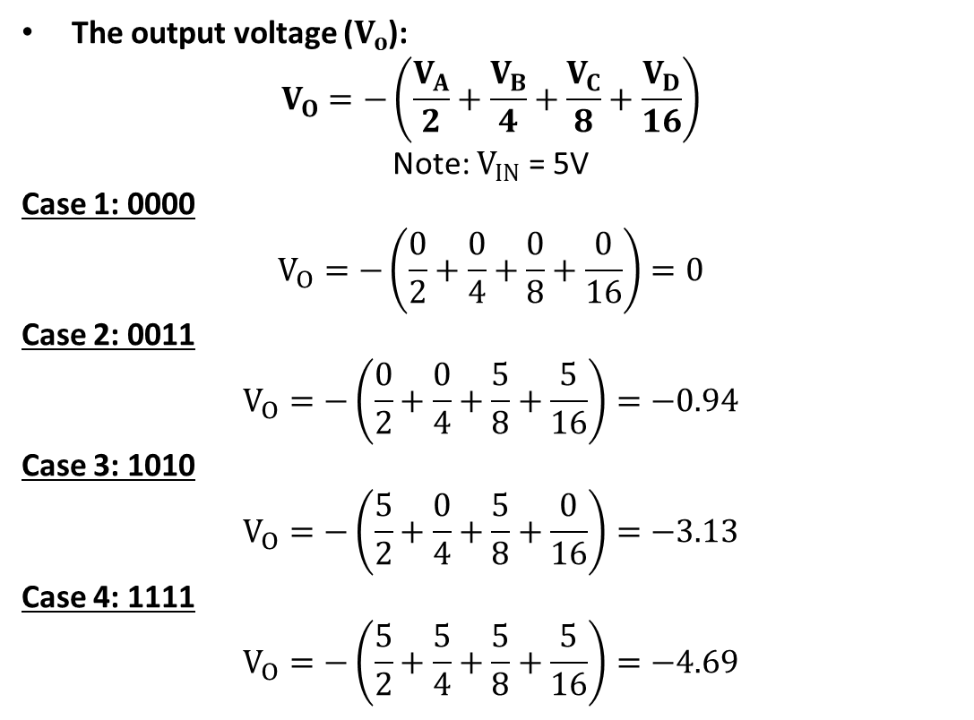
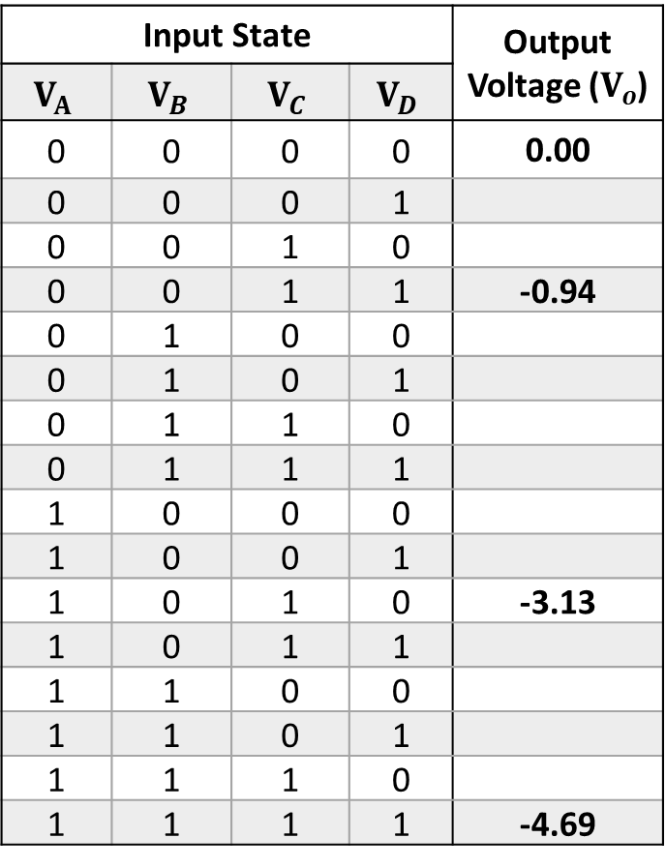
Calculate the Output Voltage ($V_{o}$)
Input State |  |  |  | Output Voltage ($V_{o}$)
$$V_{A}$$ | $$V_{B}$$ | $$V_{C}$$ | $$V_{D}$$
0 | 0 | 0 | 0 | 0.00
0 | 0 | 0 | 1
0 | 0 | 1 | 0
0 | 0 | 1 | 1 | -0.94
0 | 1 | 0 | 0
0 | 1 | 0 | 1
0 | 1 | 1 | 0
0 | 1 | 1 | 1
1 | 0 | 0 | 0
1 | 0 | 0 | 1
1 | 0 | 1 | 0 | -3.13
1 | 0 | 1 | 1
1 | 1 | 0 | 0
1 | 1 | 0 | 1
1 | 1 | 1 | 0
1 | 1 | 1 | 1 | -4.69
The output voltage ($V_{o}$):
$$V_{O}=−\left(\frac{V_{A}}{2}+\frac{V_{B}}{4}+\frac{V_{C}}{8}+\frac{V_{D}}{16}\right)$$
Note: $V_{IN}$ = 5V
Case 1: 0000
$$V_{O}=−\left(\frac{0}{2}+\frac{0}{4}+\frac{0}{8}+\frac{0}{16}\right)=0$$
Case 2: 0011
$$V_{O}=−\left(\frac{0}{2}+\frac{0}{4}+\frac{5}{8}+\frac{5}{16}\right)=−0.94$$
Case 3: 1010
$$V_{O}=−\left(\frac{5}{2}+\frac{0}{4}+\frac{5}{8}+\frac{0}{16}\right)=−3.13$$
Case 4: 1111
$$V_{O}=−\left(\frac{5}{2}+\frac{5}{4}+\frac{5}{8}+\frac{5}{16}\right)=−4.69$$

Slide 12
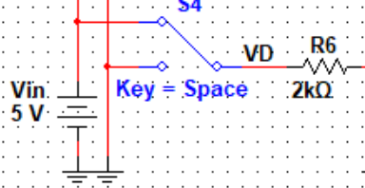
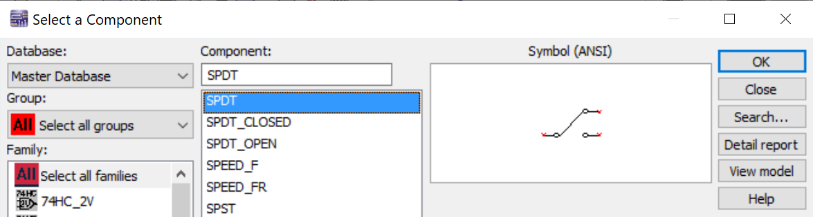
Simulation
Simulate Fig 4.10 and find the DC output voltage.
The input voltage is 5 V.
R = 1k Ohm.
1
0
1
Switch
0
1
0
1
To find switch, type SPDT in search box.
0

Slide 13
Summary
Lab 4 Report & Pre-lab 5 are due on Tuesday 16th February 2021 by midnight.
Analyze circuit in Fig. 4.10
Simulation
Calculations
Experimental results

